Slide 1


Titolo presentazione sottotitolo
Projective Synchronization
Milano, XX mese 20XX
Image Analysis and Computer Vision Project
Carlo Sgaravatti - 10660072

Slide 2
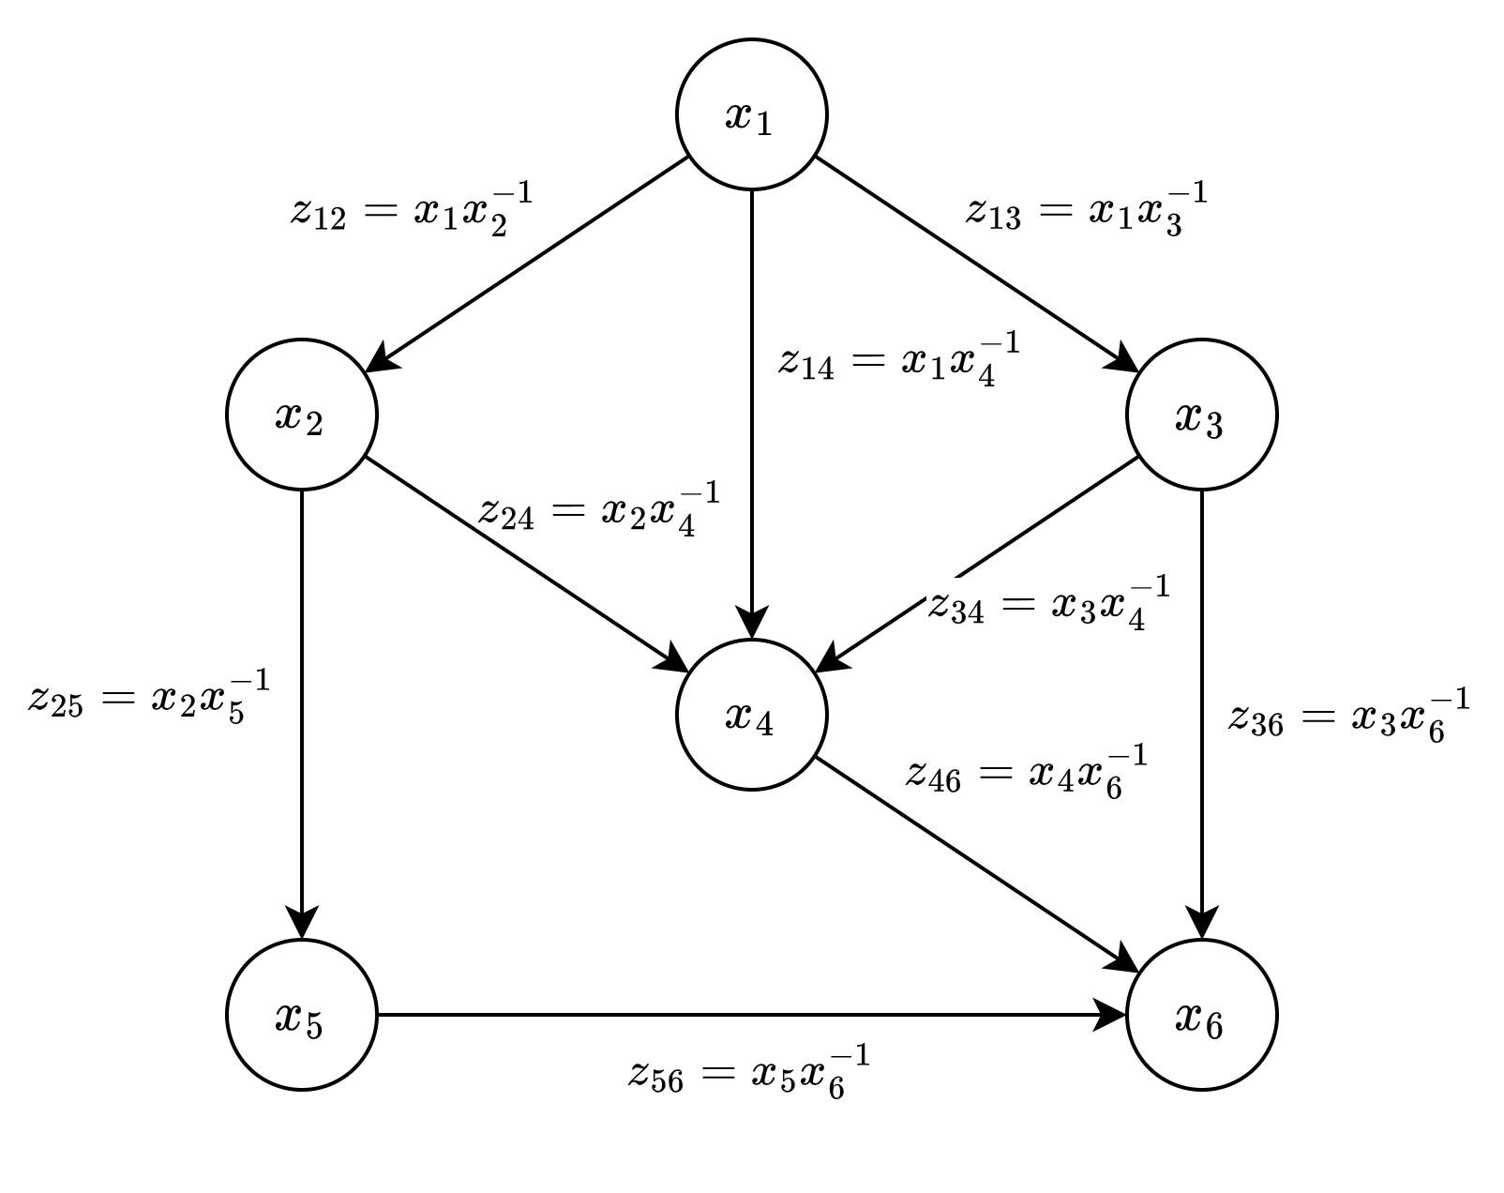
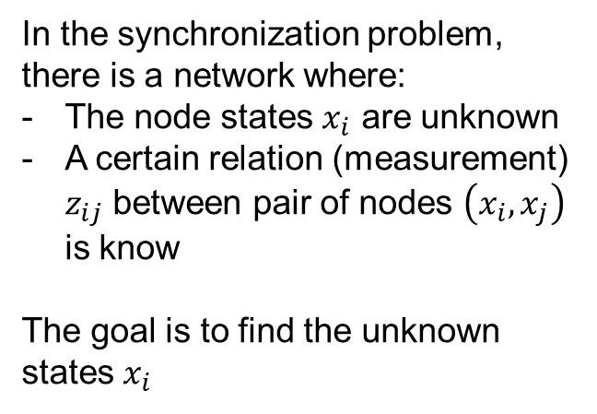
The synchronization problem
In the synchronization problem, there is a network where:
The node states $x_{i}$ are unknown
A certain relation (measurement) $z_{ij}$ between pair of nodes $\left(x_{i}, x_{j}\right)$ is know
The goal is to find the unknown states $x_{i}$
Notes:
We talk about synchronization problems when we have network in which the nodes have unknown states and a certain measurement between some pair of nodes is known. The goal of the problem is to find the unknown states.

Slide 3
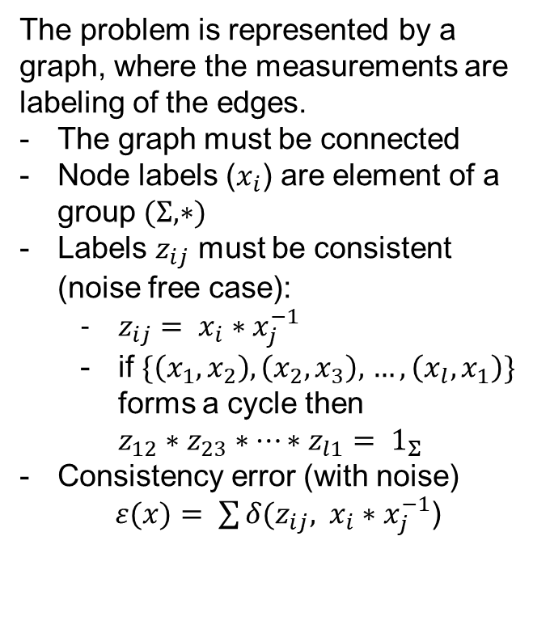
The synchronization problem
The problem is represented by a graph, where the measurements are labeling of the edges.
The graph must be connected
Node labels ($x_{i}$) are element of a group $(Σ, ∗)$
Labels $z_{ij}$ must be consistent (noise free case):
$z_{ij}= x_{i}∗x_{j}^{−1}$
if $\{\left(x_{1},x_{2}\right),\left(x_{2},x_{3}\right),$ $…, \left(x_{l},x_{1}\right)\}$ forms a cycle then $z_{12}∗z_{23}∗…∗z_{l1}= 1_{Σ}$
Consistency error (with noise)
$ε(x)= \sum{δ(z_{ij}, }$ $x_{i}∗x_{j}^{−1}$)
Notes:
More formally, the problem is represented by a so called group labelled graph, in which we have a graph whose structure is known, a certain group that represents both the states (labels) of the nodes and the measurements, and a labelling function that assigns to each edge the corresponding measurement. To have a well defined problem, the graph must be connected. A solution of the problem is a vertex labelling, that assigns to each node an element of the group. If we consider the noise free case, we can define a consistency constraint to the labelling: that the label of edge (i,j) must be equal to the label of node i multiplied by the inverse of the label of node j. As a consequence, the composition of the labels of the edges in a cycle returns the identity. In practice, however, the measurements are affected by noise, so the goal is to find a labelling of the nodes that minimizes the following consistency error, where delta is a suitable metric function.

Slide 4
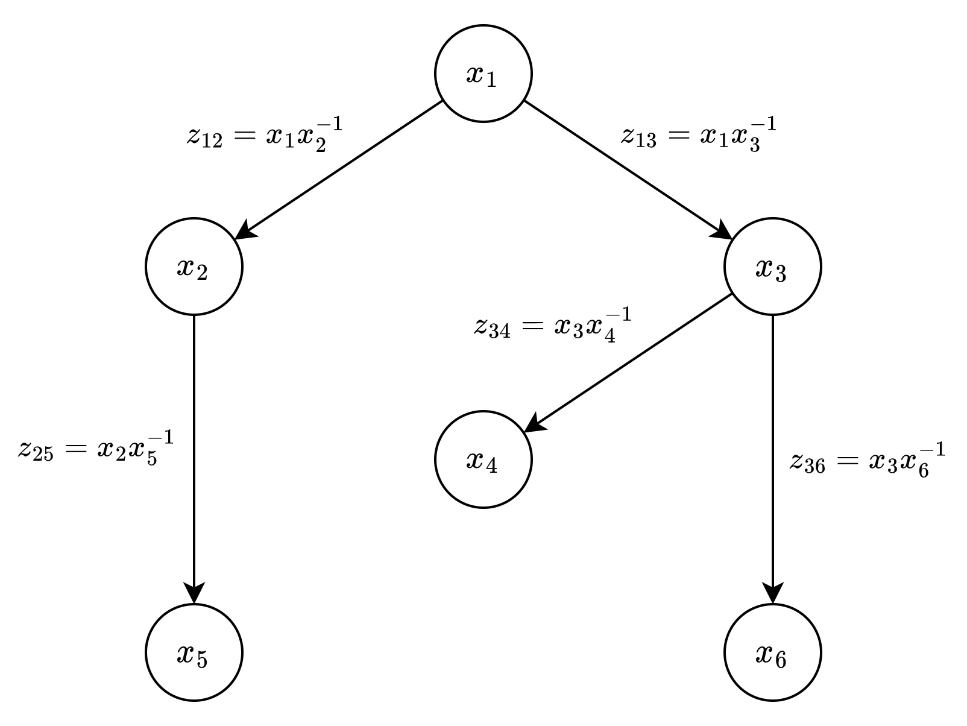
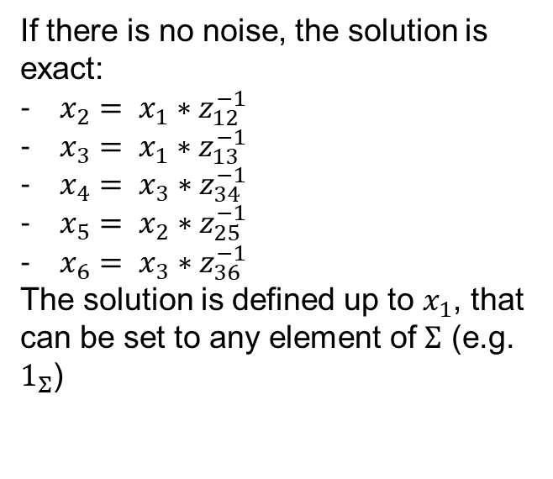
The reference solution: spanning tree approach
A basic approach consist in finding a minimum spanning tree of the measurement graph and use the consistency property to find the unknown labels of the nodes. The solution has an ambiguity: the reference node used as a root of the spanning tree (e.g. the node with the highest out degree).
If there is no noise, the solution is exact:
$x_{2}= x_{1}∗z_{12}^{−1}$
$x_{3}= x_{1}∗z_{13}^{−1}$
$x_{4}= x_{3}∗z_{34}^{−1}$
$x_{5}= x_{2}∗z_{25}^{−1}$
$x_{6}= x_{3}∗z_{36}^{−1}$
The solution is defined up to $x_{1}$, that can be set to any element of $Σ$ (e.g. $1_{Σ}$)
Notes:
A solution to the synchronization problem, independently on the particular type of group, can be found using a spanning tree approach, that will be the reference solution to compare the performances of the other implemented methods. In particular, the method finds a minimum spanning tree and then applies iteratively the consistency property to derive the unknown states. To do this, an arbitrarly element of the group must be assigned to the root of the spanning tree (usually the node with the highest degree). Usually, this is assigned to the identity element of the group. In this sense we say that the solution has an ambiguity, indeed any assignment to the reference node provides a valid solution. Considering this example, in which a spanning tree was computed using x1 as the root: if there is no noise the following is an exact solution of the problem.

Slide 5

Homography synchronization
Homography synchronization: $Σ$ is the set of 2-dimensional homographies, i.e. 3x3 invertible matrix defined up to a scale.
Homography synchronization can be used to solve the image mosaicing problem.
Notes:
We talk about homography synchronization when we deal with 2-dimensional homographies, that are 3x3 invertible matrices defined up to a scale. An application of this problem is given by the image mosaicing problem, where the goal is to align a set of images of parts of the same scene in a global mosaic of images. In this case the nodes are the images and the labels of the nodes are the global homographies that permit to align the images by applying their inverse, while the edges are local pairwise homographies between images. Using a synchronization approach permit to solve this problem in an easier way, indeed the pairwise homographies are easy to find by knowing point correspondeces or by using robust fitting algorithms if we are able to extract features from the images. However, computing the global homographies is more difficult and can lead to high errors without reasoning in a broader way like the synchronization does.

Slide 6
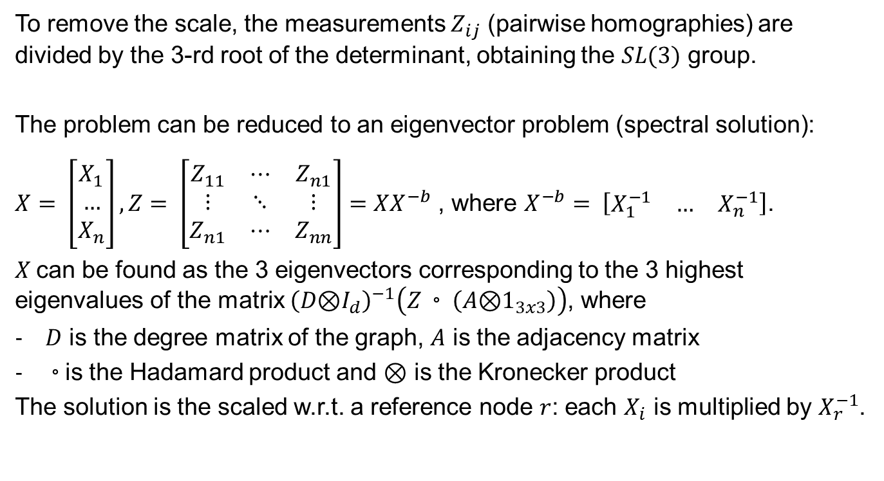
Homography synchronization – Spectral solution
To remove the scale, the measurements $Z_{ij}$ (pairwise homographies) are divided by the 3-rd root of the determinant, obtaining the $SL(3)$ group.
The problem can be reduced to an eigenvector problem (spectral solution):
$X= \left[\begin{aligned}X_{1} \\ … \\ X_{n}\end{aligned}\right], Z= \left[\begin{matrix}Z_{11} & ⋯ & Z_{n1} \\ ⋮ & ⋱ & ⋮ \\ Z_{n1} & ⋯ & Z_{nn}\end{matrix}\right]=XX^{−b}$ , where $X^{−b}= \left[\begin{matrix}X_{1}^{−1} & … & X_{n}^{−1}\end{matrix}\right]$.
$X$can be found as the 3 eigenvectors corresponding to the 3 highest eigenvalues of the matrix ${\left(D\text{⊗}I_{d}\right)}^{−1}\left(Z◦\left(A\text{⊗}1_{3x3}\right)\right)$, where
$D$ is the degree matrix of the graph, $A$ is the adjacency matrix
$◦$is the Hadamard product and $\text{⊗}$ is the Kronecker product
The solution is the scaled w.r.t. a reference node $r$: each $X_{i}$ is multiplied by $X_{r}^{−1}$.
Notes:
The homography synchronization problem can be solved by reducing the problem to an eigenvector problem. This method is called spectral solution and it requires that the measurements Zij (that are pairwise homographies) are normalized to have a unitary determinant, thus obtaining the special linear group of dimension 3. To do so, the Zij matrices are scaled by the 3° root of their determinant.
We call X the following block matrix that contains the unknown states Xi (the global homographies of the nodes), and that we call Z the block matrix containing the measurements, that is equal in the noise free case to the product between X and the inverse block matrix X –b following the consistency property. A solution X, that minimizes the consistency error, can be obtained by finding the top 3 eigenvectors corresponding to the 3 highest eigenvalues of this matrix, where A is the adjecency matrix of the graph and D is the degree matrix of the graph. The solution is then scaled with respect to a reference node.

Slide 7
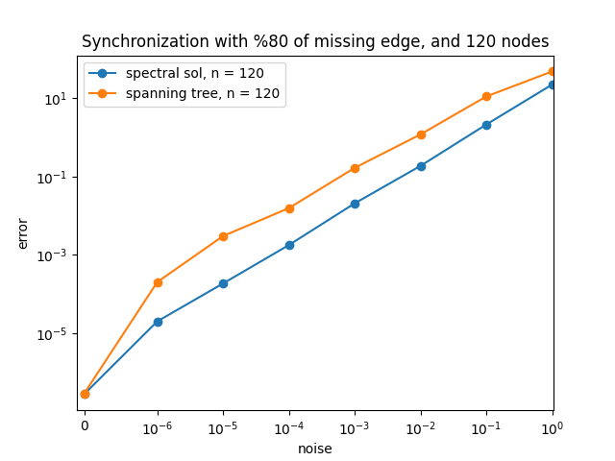
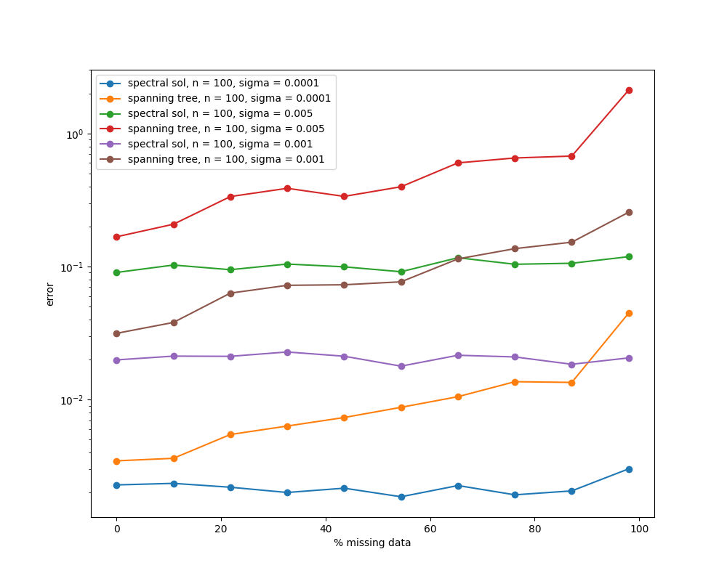
Homography synchronization
Notes:
Here we can see the results of the method, that is performing better than the spanning tree, especially when there is some noise and the percentage of missing edges is high. The first plot is comparing the performances of the spectral solution, in blue, and the spanning tree, in orange, as the standard deviation of the noise is varying. While the second plot is showing, for different values of the noise, how the two methods are performing when the percentage of missing edges in the graph is varying. In particular, the spectral solution is almost independent with respect to the percentage of missign edges, while the spanning tree performs worse as this percentage increase. The reason why the spanning tree is performing worse as the number of missing edges is increasing comes from the fact that a spanning tree in such graphs has an higher depth so the solution requires many subsequent matrix multiplications that lead to numerical errors, on the other hand, in a complete graph the spanning tree can have only one level of depth if it is computed as a shortest path tree, so every solution is produced by just one matrix multiplication.

Slide 8
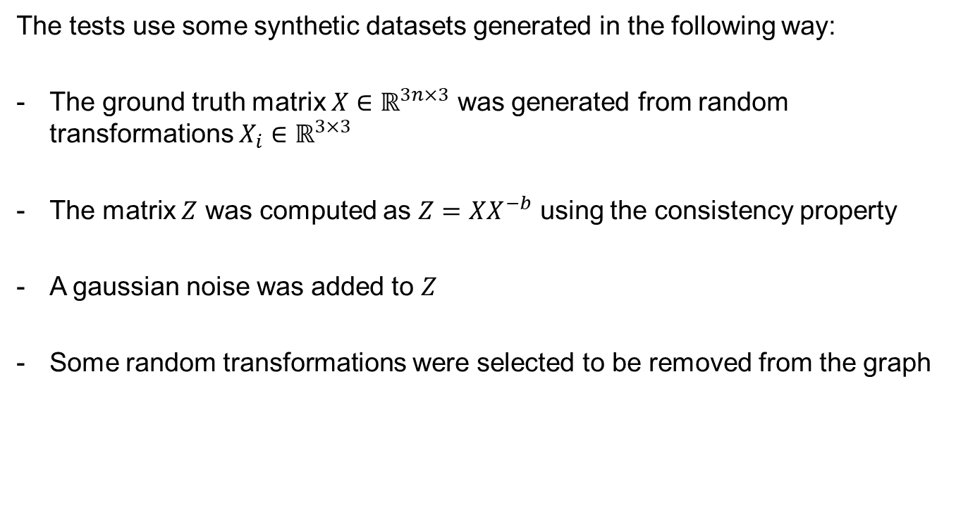
Synthetic datasets generation and error computation
The tests use some synthetic datasets generated in the following way:
The ground truth matrix $X∈ℝ^{3n×3}$ was generated from random transformations $X_{i}∈ℝ^{3×3}$
The matrix $Z$ was computed as $Z=XX^{−b}$ using the consistency property
A gaussian noise was added to $Z$
Some random transformations were selected to be removed from the graph
Notes:
The previous tests were made thanks to synthetic datasets generated in the following way: first the ground truth X was generated from random transformation. Then this was used to compute the exact matrix Z following the definintion of consistency, to which a gaussian noise was added. According to the considered percentage of missing edges, some transformations were removed from the graph by operating on the adjacency matrix.

Slide 9
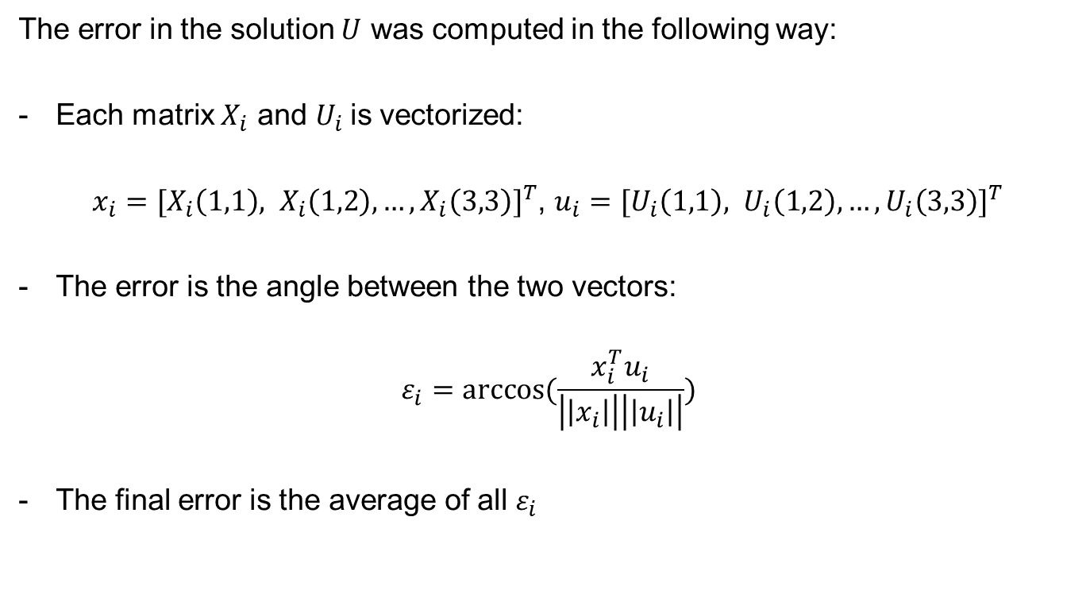
Synthetic datasets generation and error computation
The error in the solution $U$ was computed in the following way:
Each matrix $X_{i}$ and $U_{i}$is vectorized:
$x_{i}={[X_{i}\left(1,1\right), X_{i}\left(1,2\right), …,X_{i}\left(3,3\right)]}^{T}$, $u_{i}={[U_{i}\left(1,1\right), U_{i}\left(1,2\right), …,U_{i}\left(3,3\right)]}^{T}$
The error is the angle between the two vectors:
$$ε_{i}=arccos⁡(\frac{x_{i}^{T}u_{i}}{\left|\left|x_{i}\right|\right|\left|\left|u_{i}\right|\right|})$$
The final error is the average of all $ε_{i}$
Notes:
To evaluated the performances of the methods, the error was computed in the following way: given that we call U the computed solution, each Ui matrix is compared with the ground truth Xi by computing the angle between the vectorized form of the two matrices, so the total error is the average of all of these errors.

Slide 10
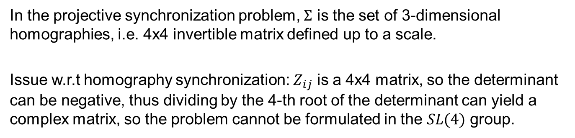
Projective synchronization
In the projective synchronization problem, $Σ$ is the set of 3-dimensional homographies, i.e. 4x4 invertible matrix defined up to a scale.
Issue w.r.t homography synchronization: $Z_{ij}$ is a 4x4 matrix, so the determinant can be negative, thus dividing by the 4-th root of the determinant can yield a complex matrix, so the problem cannot be formulated in the $SL(4)$ group.
Notes:
We talk about projective synchronization when the elements of the group are projective frames, that are 3-dimensional homographies, which means 4x4 invertible matrices defined up to a scale. One issue wrt the homography synchronization problem is that here we cannot work with the symmetric linear group since the determinant of the Zij can be negative, so dividing by the 4° root of it can yield a complex matrix.

Slide 11
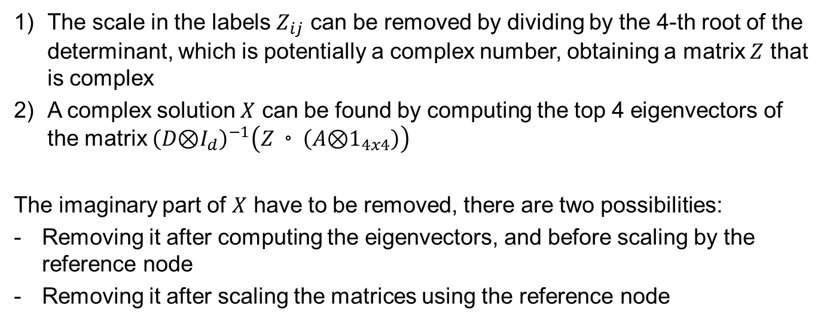
Extending the spectral solution
The scale in the labels $Z_{ij}$ can be removed by dividing by the 4-th root of the determinant, which is potentially a complex number, obtaining a matrix $Z$ that is complex
A complex solution $X$ can be found by computing the top 4 eigenvectors of the matrix ${\left(D\text{⊗}I_{d}\right)}^{−1}\left(Z◦\left(A\text{⊗}1_{4x4}\right)\right)$
The imaginary part of $X$ have to be removed, there are two possibilities:
Removing it after computing the eigenvectors, and before scaling by the reference node
Removing it after scaling the matrices using the reference node
Notes:
However, we can still extend the spectral solution by working with complex numbers. In this case the solution that we found to the eigenvector problem is a complex matrix, whose imaginary part must be removed before obtaining the true solution. Two ways of removing the complex values are considered: removing it after computing the eigenvectors, but before scaling wrt the reference node, or removing it just at the very end of the computation, after scaling the matrices.

Slide 12
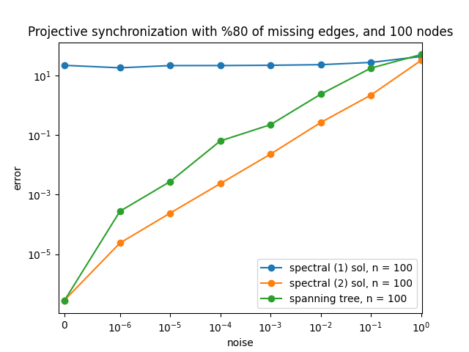
Extending the spectral solution
Notes:
This plot shows that one the last approach is feasible, in particular, the green line shows the performance of the spectral solution, the blue line shows the performance of the second approach that removes the imaginary values at the end of the computation, and the orange line is the first approach. This happens because the first approach removes the imaginary values too early and this causes a loss of information, while the scaling permit to obtain complex matrices aligned in the same direction of the complex plane so removing the values after this step can be seen as rotating the matrices by the same quantity.

Slide 13
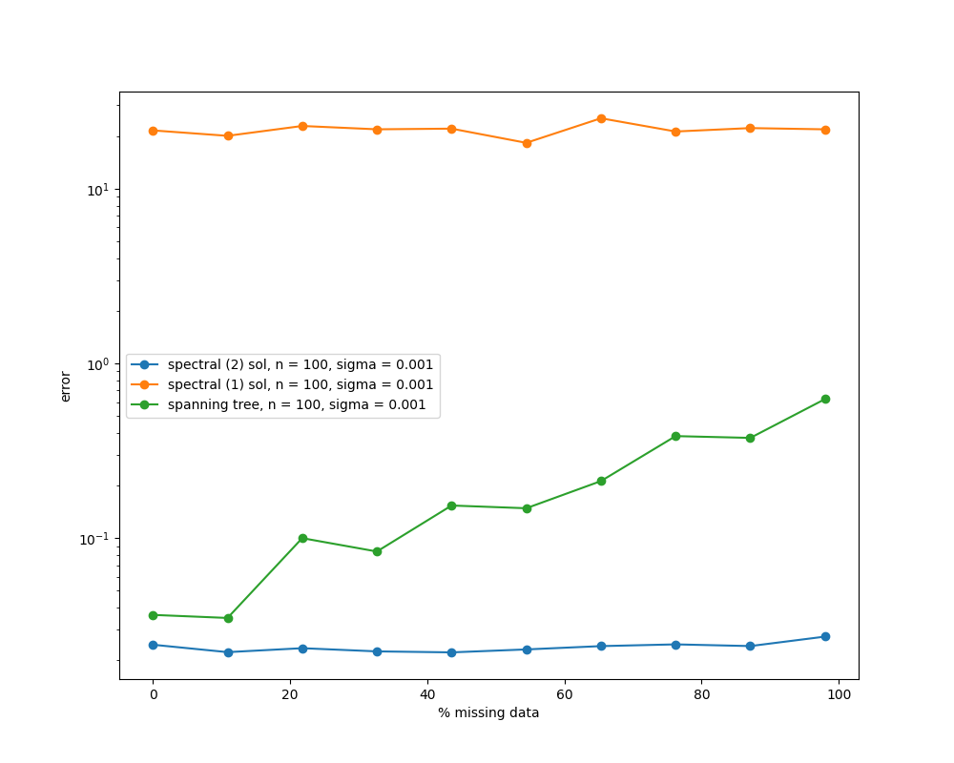
Extending the spectral solution
Notes:
The second approach permit to obtain a very similar behaviour with respect to the homography synchronization problem, where the performance of the method is independent with respect to the percentage of missing edges.

Slide 14
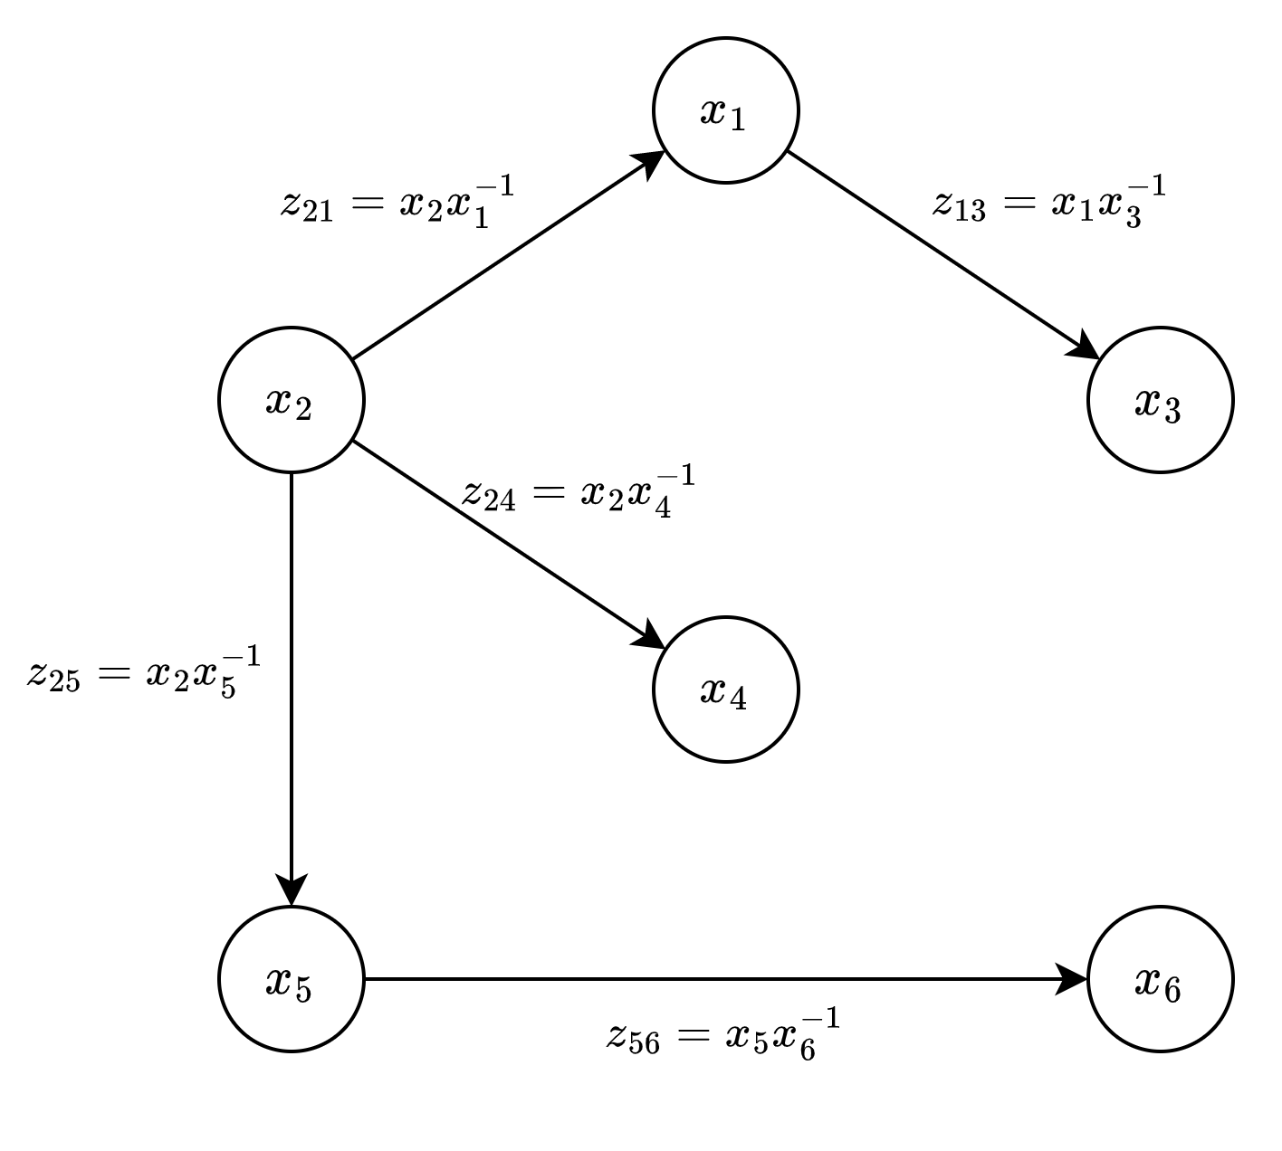
Multi-Source Propagation
In the spanning tree approach, the root of the tree can be chosen in different ways. Multi-Source Propagation exploit this fact by aggregating different solutions from different spanning trees.
Notes:
Another approach considered for the projective synchronization problem is called Multi Source Propagation. This method is based on the fact that mutliple spanning trees can be computed from the same graph using different root nodes. For example here we have two minimum spanning trees, one having node 1 as a root and one node 2.

Slide 15
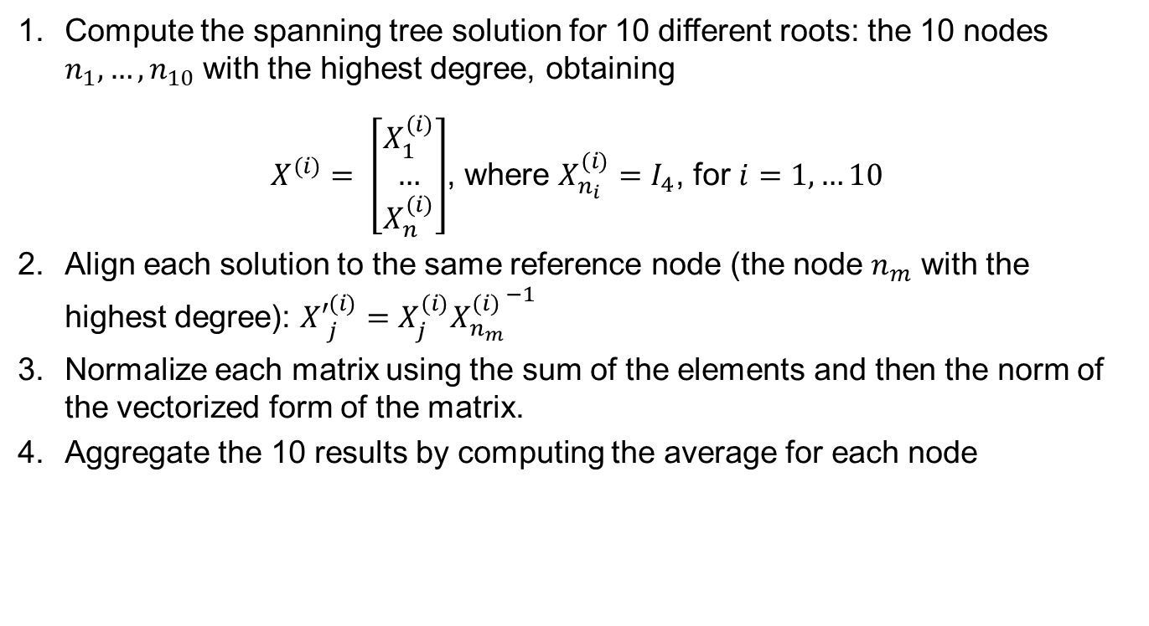
Multi-Source Propagation
Compute the spanning tree solution for 10 different roots: the 10 nodes $n_{1}, …, n_{10}$ with the highest degree, obtaining
$X^{(i)}= \left[\begin{aligned}X_{1}^{(i)} \\ … \\ X_{n}^{(i)}\end{aligned}\right]$, where $X_{n_{i}}^{(i)}=I_{4}$, for $i=1, …10$
Align each solution to the same reference node (the node $n_{m}$ with the highest degree): ${X′}_{j}^{(i)}=X_{j}^{(i)}{X_{n_{m}}^{(i)}}^{−1}$
Normalize each matrix using the sum of the elements and then the norm of the vectorized form of the matrix.
Aggregate the 10 results by computing the average for each node
Notes:
The method performs the following steps: a spanning tree solution is computed using 10 different roots, that are the 10 nodes with the highest degree, obtaining 10 different solutions. Each of those solutions has a different reference node, so they have to be aligned. Thus, each solution is scaled wrt to the node with the highest degree. Then each matrix is normalized by dividing first by the sum of the elements and then by the norm of the vectorized form of the resulting matrix. In the end the 10 solutions are aggregated by computing an empiric mean.

Slide 16
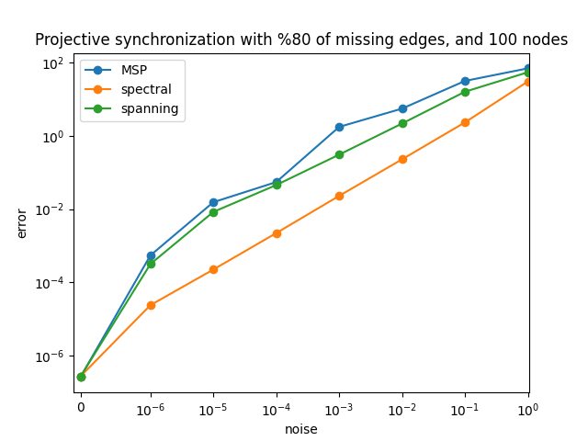
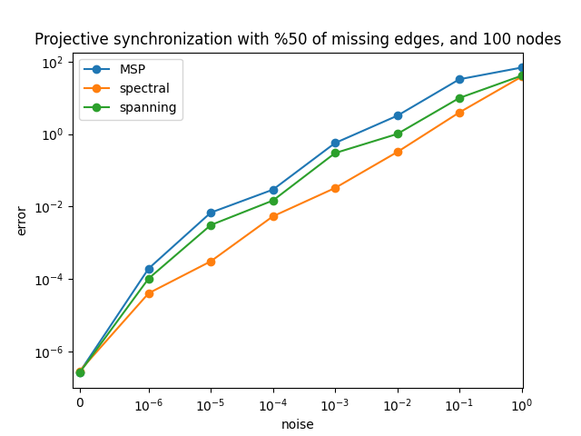
Multi-Source Propagation
Notes:
Here we can see the results with different values of missing edges, where the multi source propagation is not improving the spanning tree solution

Slide 17
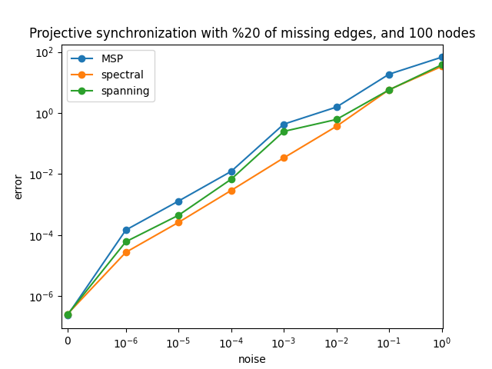
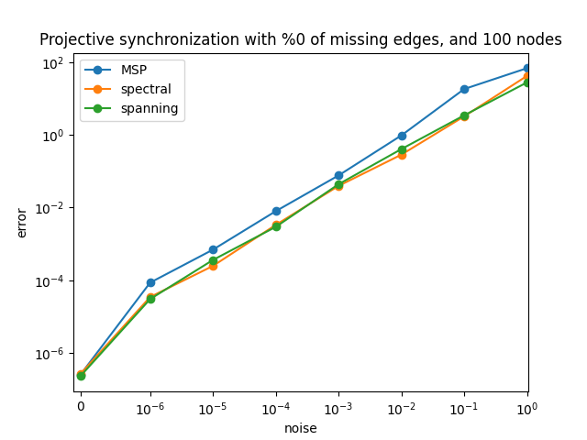
Multi-Source Propagation
Notes:
Similarly to what observed before, the performances of the methods are much similar to the spectral soltuion when the number of missing edges is low, but the multi source propagation is performing worse even with complete graphs.

Slide 18
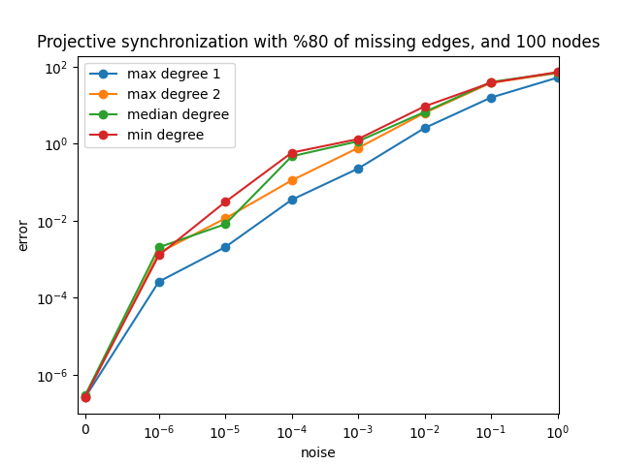
Multi-Source Propagation
Notes:
The reason why this happens can be explained by this plot. In particular, here the spanning tree solution is compared using 4 different roots: the node with the highest degree, the second node with the highest degree, the median degree node and the node with the smallest degree. All the solutions are aligned to the node with the highest degree. Thus aligning the solutions is the step that provides the largest error (indeed this step is not required to be done in the case of the maximum degree node since the obtained solution is already aligned), since it requires the computation of the inverse of a matrix and then the multiplication with that matrix to all other matrices, so we have some numerical errors that add up to the spanning tree solution errors.

Slide 19
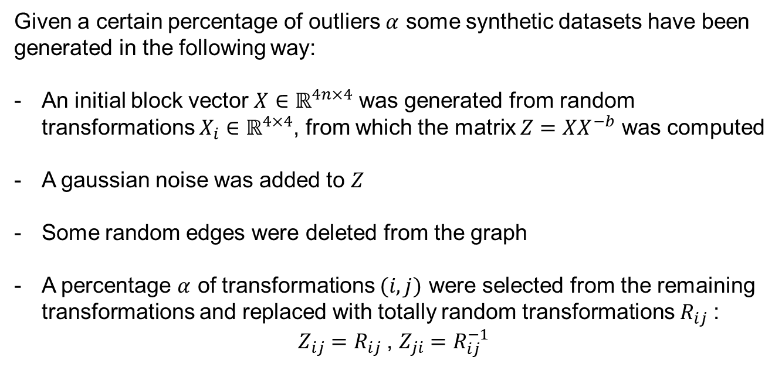
Tests with outliers
Given a certain percentage of outliers $α$ some synthetic datasets have been generated in the following way:
An initial block vector $X∈ℝ^{4n×4}$ was generated from random transformations $X_{i}∈ℝ^{4×4}$, from which the matrix $Z=XX^{−b}$ was computed
A gaussian noise was added to $Z$
Some random edges were deleted from the graph
A percentage $α$ of transformations $(i,j)$ were selected from the remaining transformations and replaced with totally random transformations $R_{ij}$:
$Z_{ij}=R_{ij}$, $Z_{ji}=R_{ij}^{−1}$
Notes:
Finally, some tests with outliers were performed, were the datasets were generated in a similar way to the previous described procedure, then some transformations were selected of the graph and replaced by totally random transformations.

Slide 20
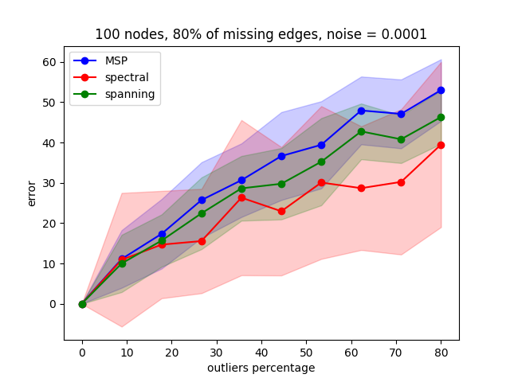
Tests with outliers
Notes:
Different tests with different percentage of missing edges were performed. When the number of missing edges is high the spectral solution is still performing better, but one thing that can be noticed is that it is much more variable than the other methods (since the highlighted area that represents the standard deviation over 30 repeated tests is much larger)

Slide 21
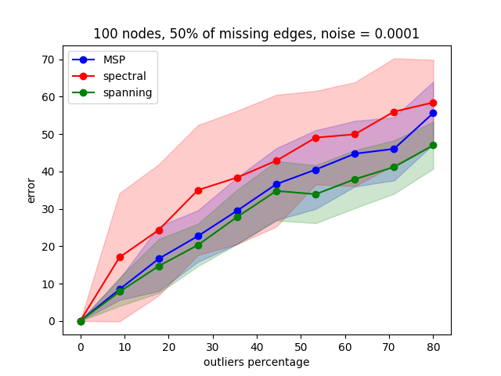
Tests with outliers
Notes:
As the number of missing edges is increasing, the performances of the spectral solution is increasing while the other methods perform similarly.

Slide 22
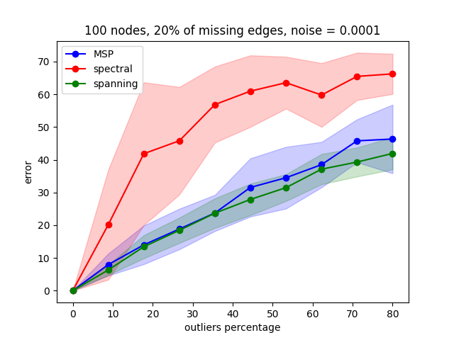
Tests with outliers
Notes:
This can be partially explained by the fact that having less missing edges result in much more cycles in the graph so the consistency property is more easily violated.

Slide 23
Conclusions
The extension of the spectral solution using complex matrices permit to obtain similar results w.r.t. the homography synchronization problem.
The Multi Source Propagation does not improve the spanning tree solution because of numerical errors due to many matrix multiplications
The extension of spectral solution to the projective synchronization gives the best results but is not robust to the presence of outliers. Further analysis is required to understand and fix this behaviour
Notes:
A conclusion that we can give is that it is possible to extend the methods used to solve the homography synchronization problem to the projective synchronization framework. The spectral solution permit to obtain the best results, while Multi-Source propagation is affected by some numerical errors. Further analysis is requred to fix the behaviour of the spectral solution when there are outliers.

